Slide 1
<Spring Security>
<Arayik harutyunyan>

Slide 2
Spring security
What is Spring Security
Spring Security Fundamentals
Spring Security Workflow
Spring Security Architecture
Spring Security Configuration
Spring Security types - Basic, JWT, Oauth2

Slide 3
Introduction: Spring Framework vs. Spring Boot vs. Spring Security
Spring Framework is a Java platform that provides comprehensive infrastructure support for developing Java applications.
Spring Boot is based on the Spring Framework, providing auto-configuration features to your Spring applications and is designed to get you up and running as quickly as possible.
Spring Security provides comprehensive security services for Java_EE based software applications. There is a particular emphasis on supporting projects built using the Spring Framework.

Slide 4
What is Spring Security?
Spring Security is a framework that focuses on providing both authentication and authorization (or “access-control”) to Java web application and SOAP/RESTful web services.
Spring Security currently supports integration with all of the following technologies:
› HTTP basic access authentication
› LDAP system
› OpenID identity providers
› JAAS API
› CAS Server
› ESB Platform ›
› Your own authentication systems
› It is built on top of Spring Framework

Slide 5
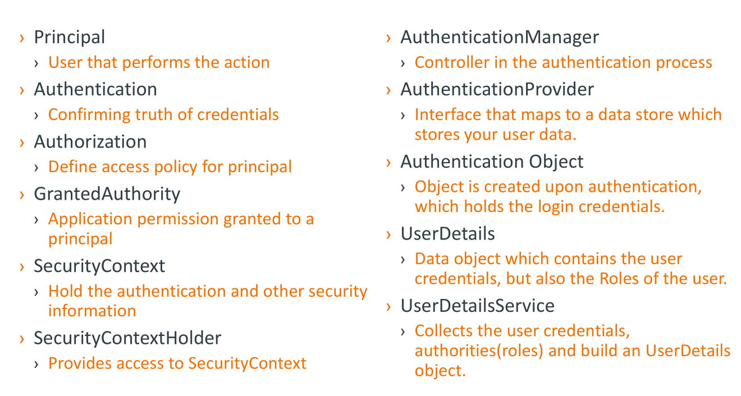
Spring Security fundamentals

Slide 6
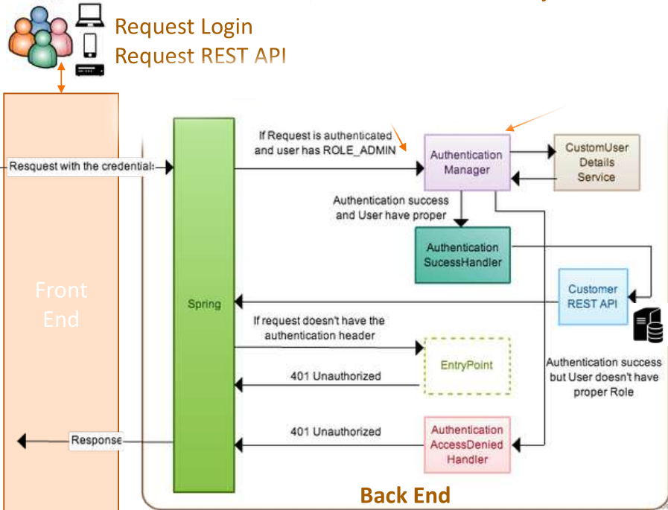
Spring Security Common Workflow

Slide 7
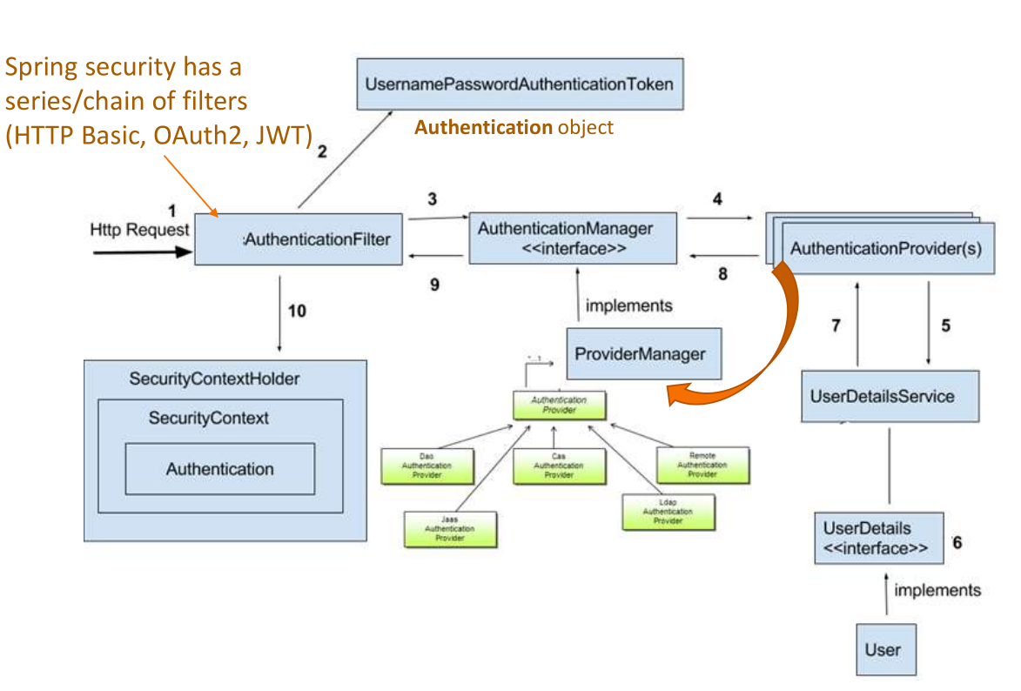
Spring Security Architecture

Slide 8
Spring Security configuration 1) In-Memory Authentication 2) JDBC Authentication 3) LDAP Authentication 4) User Details Service 5) Authentication Provider

Slide 9
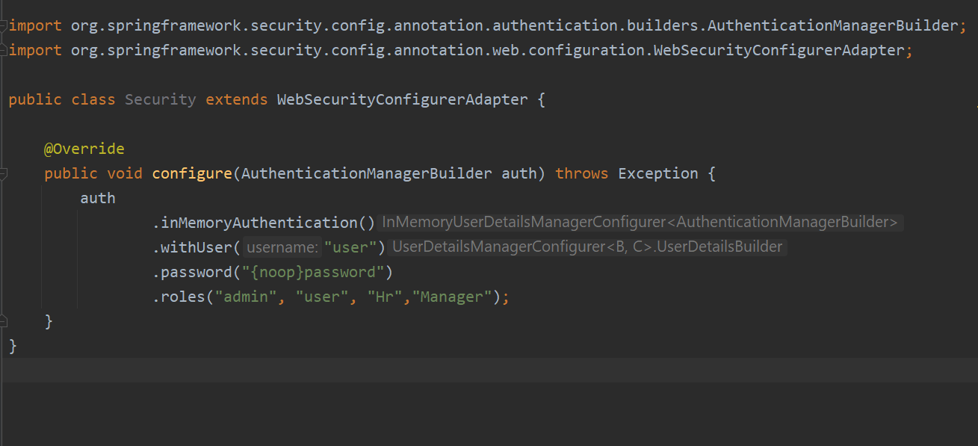
In-Memory Authentication In-memory authentication is usually used in development phase

Slide 10
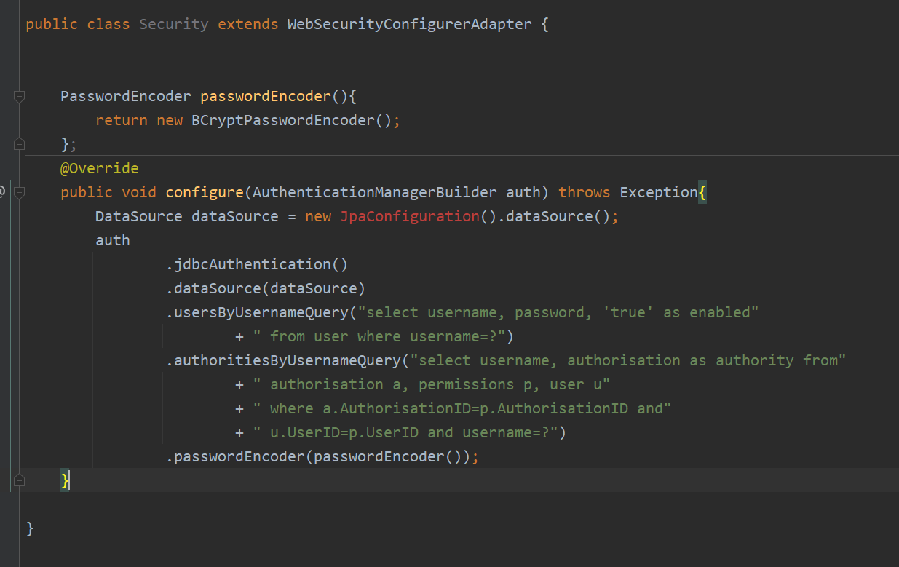
JDBC Authentication

Slide 11
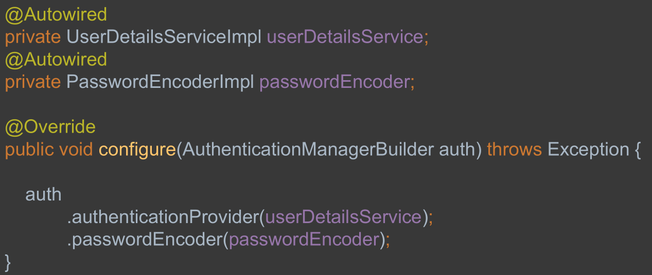
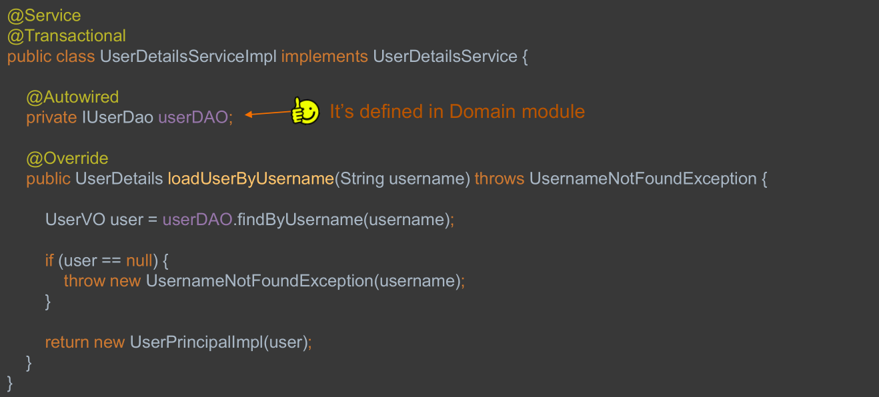
UserDetailsService

Slide 12
Spring Security Fundamentals 2
JWT (JSON Web Tokens)
It is just a token format. JWT tokens are JSON encoded data structures
containing information about issuer, subject (claims), expiration time, etc.
JWT is simpler than SAML 1.1/2.0, is supported by all devices.
OAuth2 is a framework that solves a problem when a user wants to access
the data using a client software like browser-based web apps, native
mobile apps or desktop apps. OAuth2 is just for authorization, client
software can be authorized to access the resources on behalf of the
end user by using an access token.

Slide 13
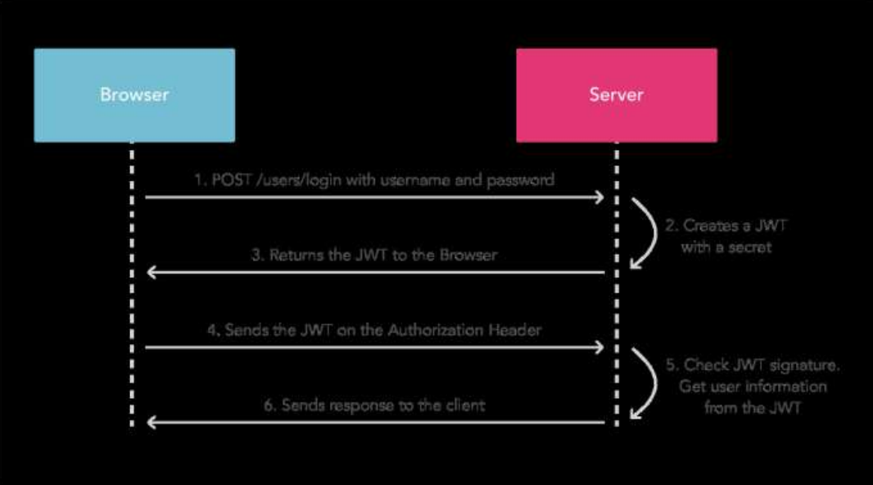
JSON Web Token (JWT) with REST API

Slide 14
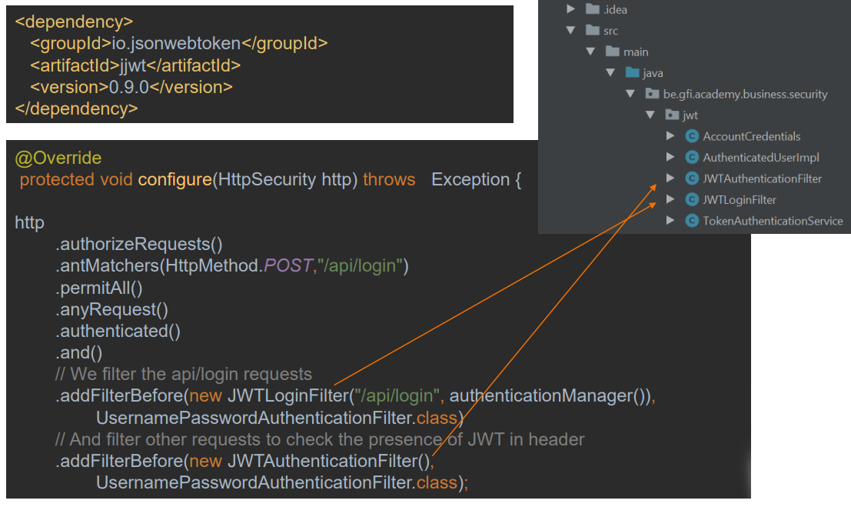
JSON Web Token (JWT) with REST API Configuration

Slide 15
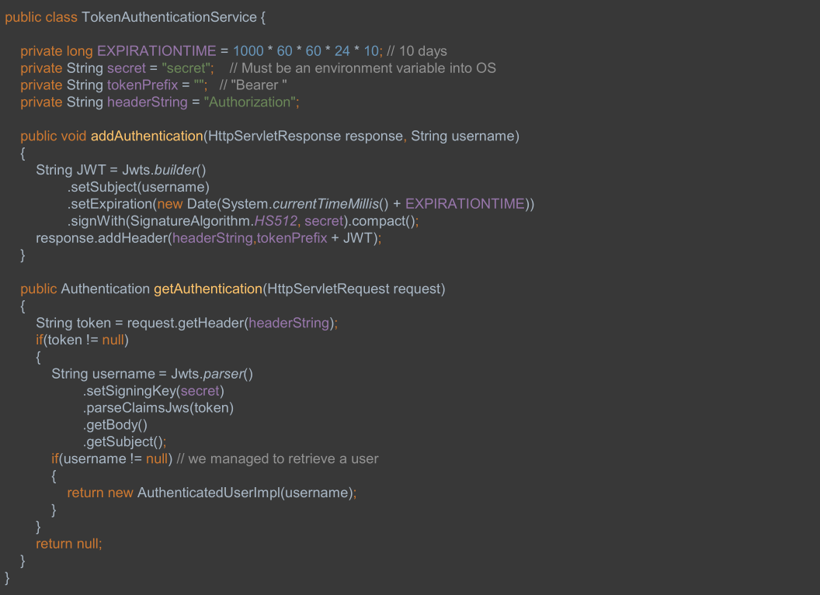

Slide 16
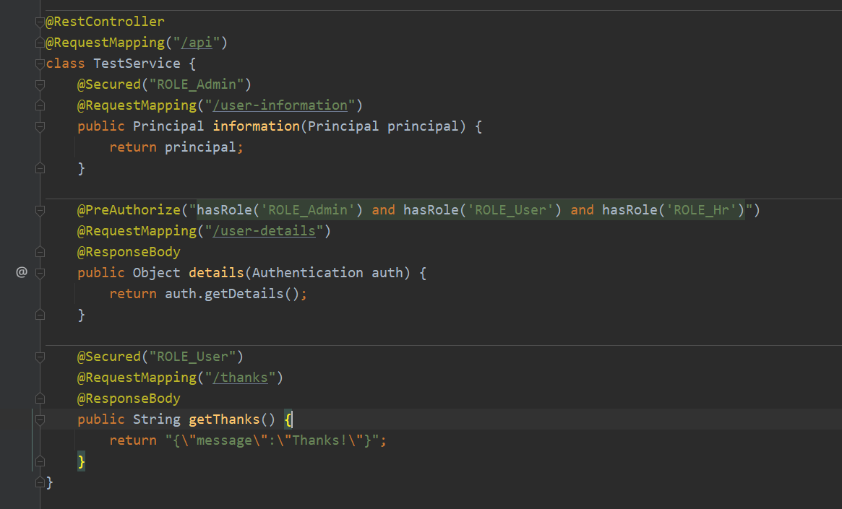
Spring security with rest api

Slide 17
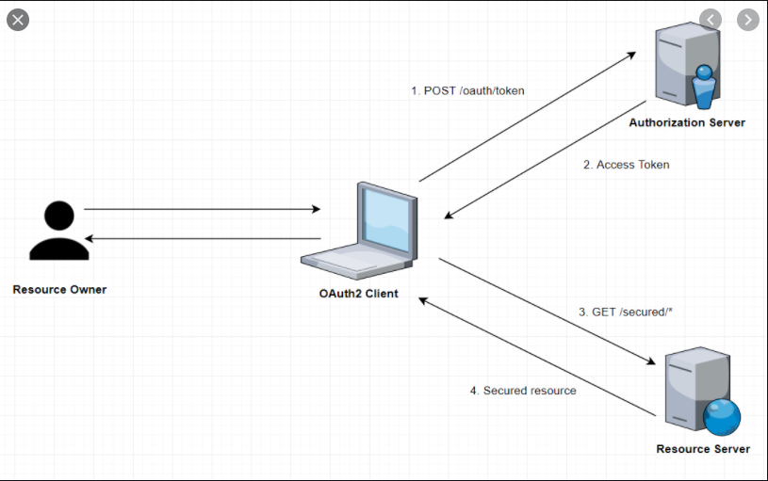
Oauth 2 WorkFlow

Slide 18
Useful links.
https://pattern-match.com/blog/springboot2-with-oauth2-integration/
https://medium.com/@darutk/the-simplest-guide-to-oauth-2-0-8c71bd9a15bb
https://spring.io/guides/tutorials/spring-boot-oauth2/
https://medium.com/google-cloud/understanding-oauth2-and-building-a-basic-authorization-server-of-your-own-a-beginners-guide-cf7451a16f66

Slide 19


